Slide 1
Incision Quality And Clinical Outcomes of Femtosecond Laser-assisted Arcuate Incisions Created During Cataract Surgery
Presented by: Dan B. Tran, MD

Slide 2
Introduction
High precision in the width, depth, and arc length of the femtosecond laser-created arcuate keratotomy (FSAK) incisions has improved the astigmatic outcomes following arcuate keratotomy.
Beveled incisions perpendicular to the coronal plane decrease the chances of regression and improve astigmatic stability.
Despite these advantages, the residual tissue bridges in FSAK incisions limit the refractive predictability of the procedure.
Lensar’s ALLY femtosecond laser is a dual-pulse-width laser that uses a pulse width of 1500 fs to fragment the lens and 320 fs to cut the cornea.
  This optimizes cutting efficiency based on the tissue being targeted, decreasing the incidence of residual tissue bridges in corneal incisions.

Slide 3
Purpose
To evaluate the ease of opening and effectiveness of arcuate incisions (AI) created with dual pulse width femtosecond laser (ALLY Adaptive Cataract Treatment System, Lensar) for the correction of preexisting corneal astigmatism in patients undergoing femtosecond laser-assisted cataract surgery.

Slide 4
Methods
Study design: Prospective study.
Study procedure
Scale used
Outcome measures
36 eyes of 31 patients underwent femtosecond laser-assisted arcuate incisions (AIs) during cataract surgery.
AIs were created with the dual-pulse femtosecond laser (ALLY) using a pulse width of 1500 fs to fragment the lens and 320 fs to cut the cornea.
Ease of opening of AIs was assessed at a scale of 1 to 5.
1 = unable to open AI (sharp keratome required).
2 = able to partially open AI, keratome required for completion.
3 = able to partially open AI, blunt instrument required for completion.
4 = AI easy to open with blunt instrument.
5 = AI fully open.
Mean score and frequency distribution of ease of opening of AIs

Slide 5
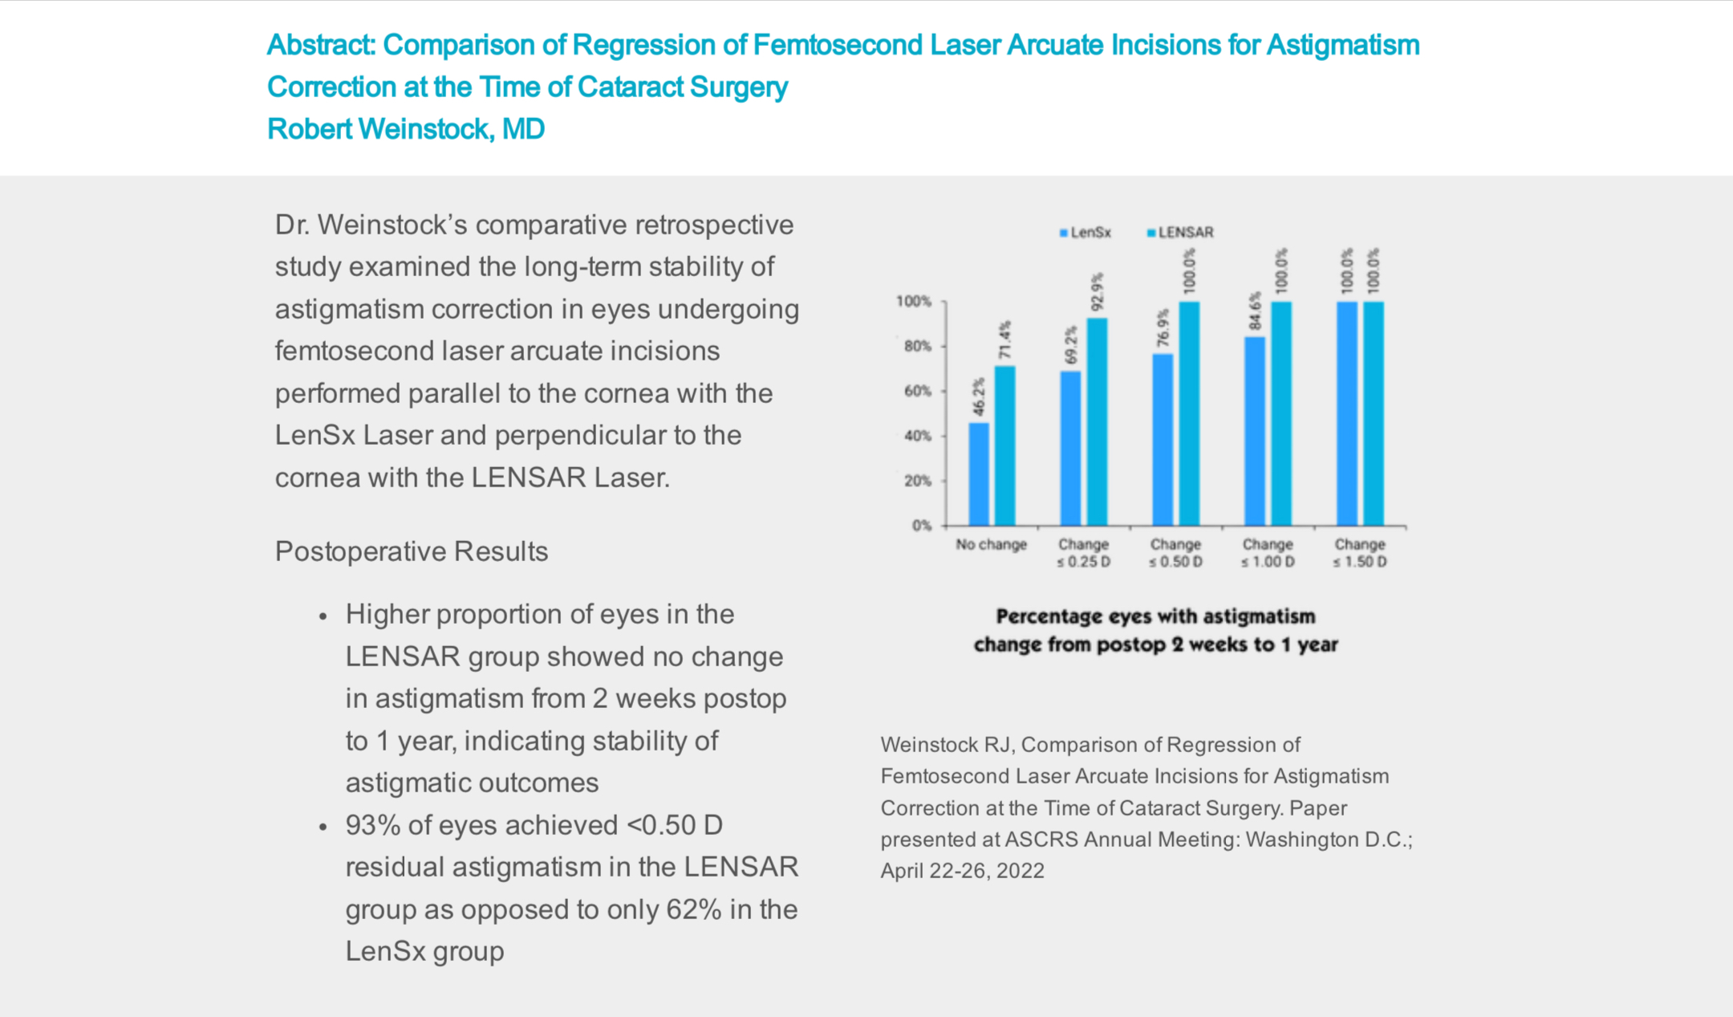
Arcuate Incision Stability
A comparative retrospective study looking at the long-term stability of astigmatism correction in eyes undergoing arcuate incisions performed parallel to the cornea with the LenSx laser and perpendicular to the cornea with the LENSAR laser.
Higher proportion of eyes in the LENSAR group showed no change in astigmatism from 2 weeks postop to 1 year, indicating stability of astigmatic outcomes
93% of eyes achieved ˂0.50D residual astigmatism in the LENSAR group as opposed to only 62% in the LenSx group
Weinstock RJ, Comparison of Regression of Femtosecond Laser Arcuate Incisions for Astigmatism Correction at the Time of Cataract Surgery. Paper presented at ASCRS Annual Meeting. Washington, D.C. April 2022.

Slide 6
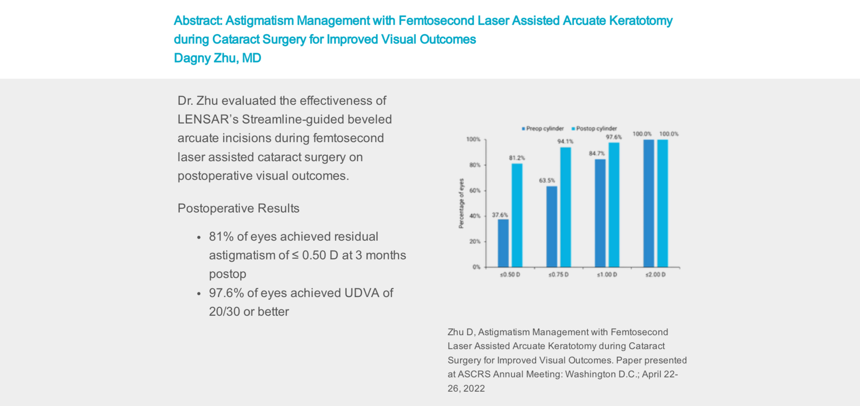

Astigmatism Management
An evaluation of the effectiveness of LENSAR’s Streamline-guided beveled arcuate incisions during femtosecond laser assisted cataract surgery on postoperative visual outcomes.
81% of eyes achieved residual astigmatism of ≤0.50D at 3 months postop
97.6% of eyes achieved UDVA of 20/30 or better
Zhu D, Astigmatism Management with Femtosecond Laser Assisted Arcuate Keratotomy during Cataract Surgery for Improved Visual Outcomes. Paper presented at ASCRS Annual Meeting. Washington, D.C. April 2022.

Slide 7
Results
The mean score for the ease of opening of arcuate incisions was 4.33 ± 0.61 when assessed on a scale of 1 to 5, indicating that the incisions were either fully open or were easily opened using a blunt instrument.

Slide 8
Results
The surgeon was able to open 92.6% of the arcuate incisions either without using any instrument or with minimal touch of a blunt instrument.

Slide 9
Discussion
In the present study, the AKs created with ALLY dual-pulse femtosecond laser were easy to open.
Almost 93% of the incisions opened easily without the use of any instrument or with minimal touch of a blunt instrument.
FSAK performed with LENSAR laser has been reported to yield excellent astigmatic outcomes.¹
With ALLY dual pulse laser, using a 320 fs laser beam for corneal cutting minimizes the issue of residual tissue bridges, allowing surgeons to open FSAK incisions easily.
This allows the surgeons to incorporate FSAK into their routine clinical practice and address preexisting corneal astigmatism with precision.
1. Visco et al., J Cataract Refract Surg 2019.

Slide 10
Thank You

